Slide 1
Intellitune
Automatic ham radio antenna tuner

Slide 2




Team Members
Preston Peranich
Jonah Stevens
Haley Knable
Noah Ihediwa
Electrical Engineering
Team Lead
Electrical Engineering
Electrical Engineering
Electrical Engineering

Slide 3

Faculty Advisor
Education/Qualification
BS, Electrical and Electronics Engineering, Bogazici University, 2003
MS, Electrical and computer Engineering, George Washington University, 2005
PhD, Electrical and Computer Engineering, George Washington University, 2009
Relevant Research and Interest
Microwave and Millimeter-wave Remote Sensing
RF Sensors and Systems
Antennas and Computational Electromagnetics
Dr. Mehmet Kurum
[1]

Slide 4
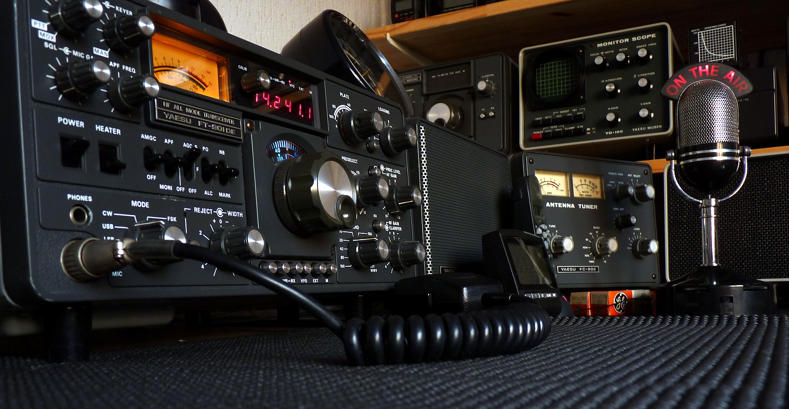
Ham Radio Introduction
[2]

Slide 5
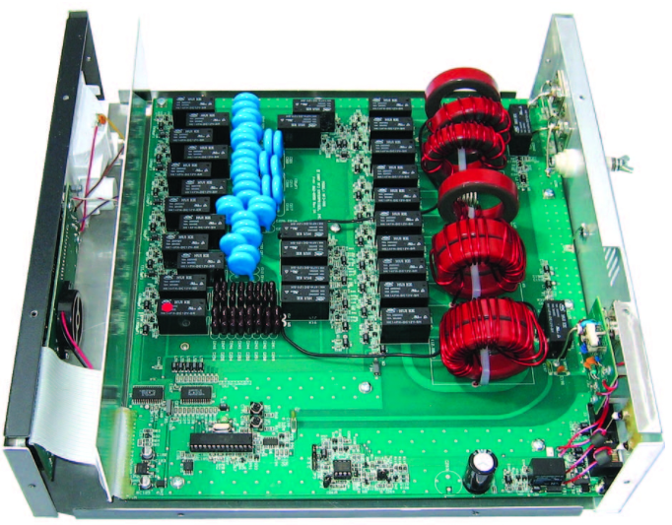
Problem Statement
Amateur Radio Application of Antenna Tuning Unit (ATU)
Manual vs. Automatic Tuning
MFJ-998 Model
[3]

Slide 6
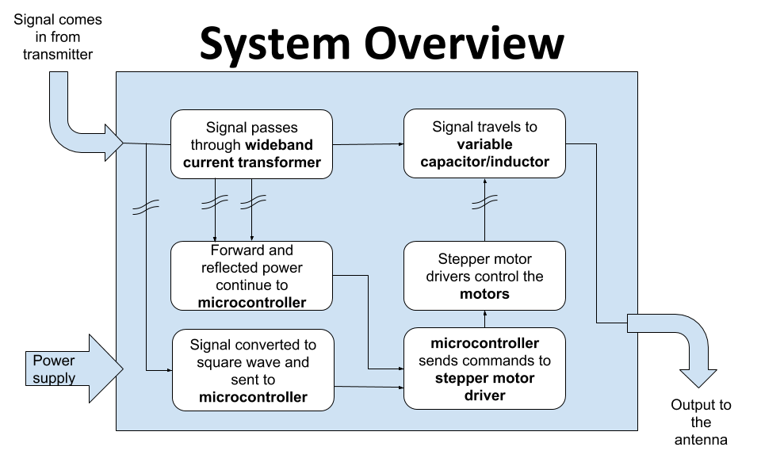

Slide 7
Technical Constraints
Name | Description
Power Rating | Handle 1.5 kW of power
Bandwidth | Pass through frequencies from 1.5 MHz to 30 MHz
VSWR Sensing | Determine the voltage standing wave ratio (VSWR) up to a 32:1 mismatch.
Frequency Sampling | Sample the transmitting signal and determine frequency up to 30 MHz
Impedance Matching | Provide a tuning network that can match impedances from 12-1600 ohms

Slide 8

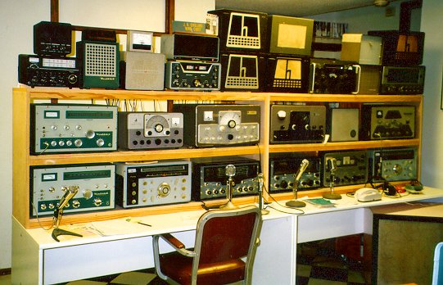
Practical Constraints
User Safety [4]
Product Size [5]

Slide 9
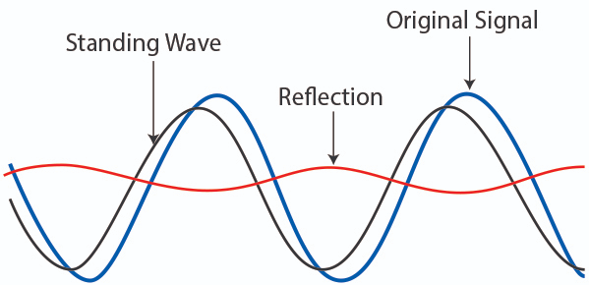
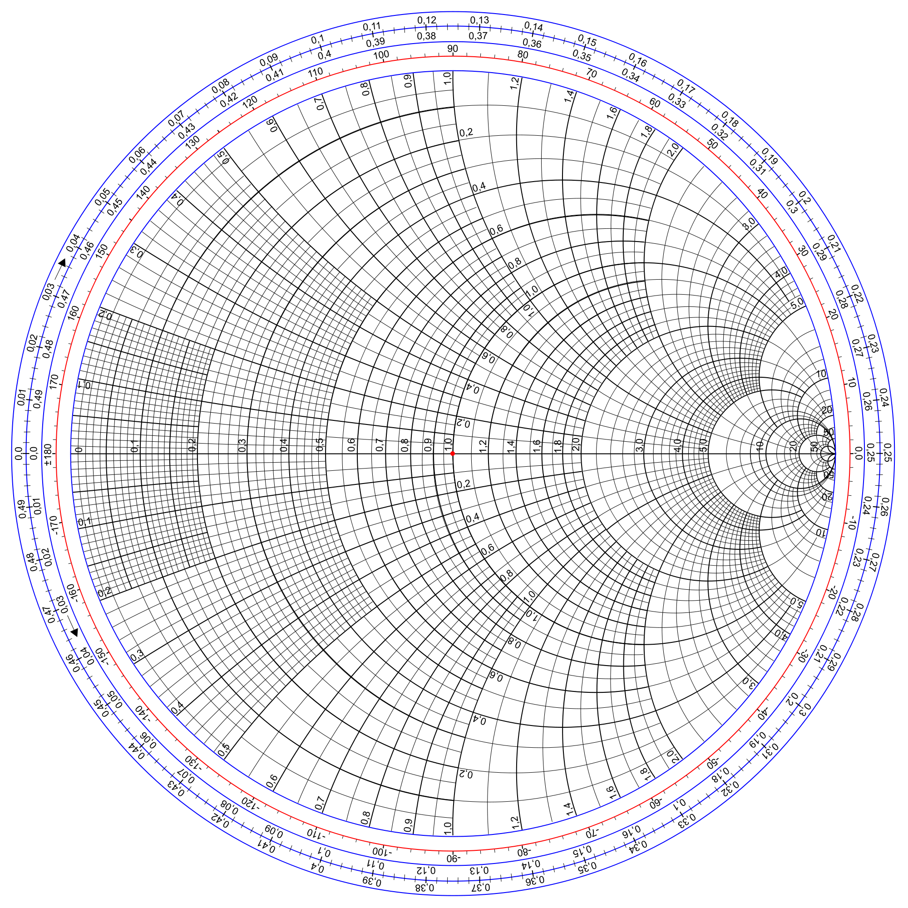
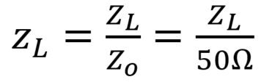
What is Standing Wave Ratio?
z_{L}
[6]
Circle on chart represents constant SWR along transmission line.
All impedances normalized.
z_{in}
λ

Slide 10
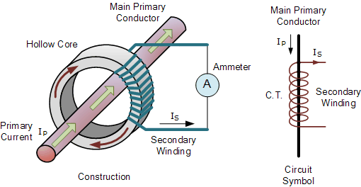
Standing Wave Ratio Sensor
A wide band current transformer will sense forward and reflected power on the feedline, with outputs connected to microcontroller.
[7]

Slide 11
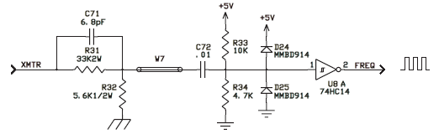
Frequency Counter
•Schmitt Trigger converts analog RF signal to square wave
•Input conditioning for safe voltages
[8]

Slide 12
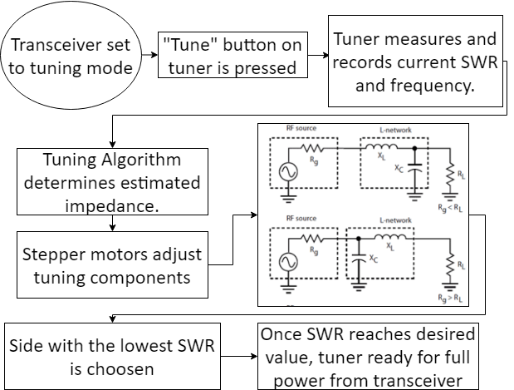
Tuning Process

Slide 13
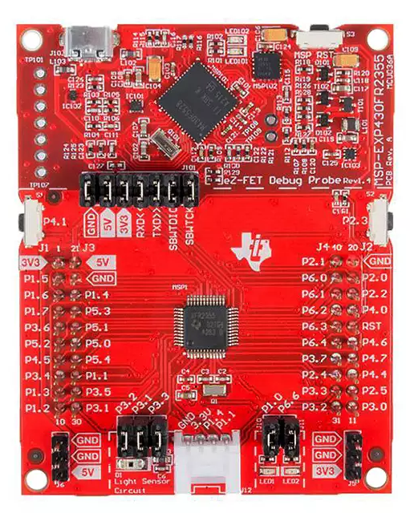
Microcontroller
Microcontroller | GPIO Pins | Clockspeed | Price | Decision
Arduino Uno Rev3 | 14 | 16 MHz | $22.00 | No
Raspberry Pi 3 Model B+ | 40 | 1.4 GHz | $35.00 | No
Ti MSP430 LaunchPad | 40 | 24 MHz | $12.99 | Yes
[9]
→ 256kB FRAM
→ JTAG interface

Slide 14
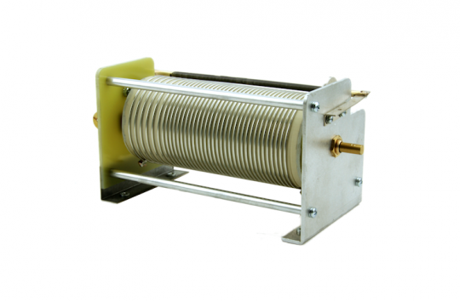
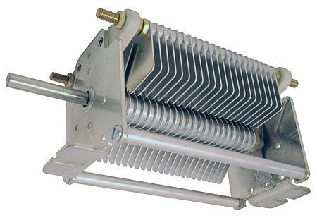
Variable Components
Variable Inductor
31 Revolution Cycle
Satisfies 1.5-30 MHz tuning range
Variable Capacitor
One revolution Cycle
500pf range

Slide 15
Motors
Motor | Nema 23 [10] | Nema 17 geared[11] | Nema 11 geared[12] | Nema 17[13]
Operating Voltage | 4.95 V | 12 V | 6.2 V | 2.3 V
Operating Current | 1.7 A | 0.4 A | 0.067 A | 2.8 A
Step Angle | 1.8 | 0.067 | 0.018 | 1.8
Price | $25.91 | $26.87 | $34.72 | $55.59
Decision | Yes | Yes | No | No

Slide 16
Drivers
Name | Big Easy Driver [14] | EasyDriver [15] | Adafruit Motor Shield V2 [16] | 1460-1159 [17]
Driving Voltage | <30 V | 6 - 30 V | 4.5 - 13.5 V | 4.75-46 V
Driving Current | <2 A | <1 A | <1.2 A | <1.1 A
Price | $19.95 | $14.95 | $19.95 | $8.06
Decision | Yes | Yes | No | No

Slide 17
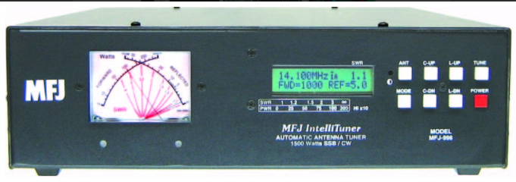
Enclosure + User interface
Material | Stainless Steel | Aluminum
Manufacturing Times[18][19] | Varies but typically longer | Varies but typically shorter
Weight per cu./ft in pounds[20] | 494.21 | 168.48
Price per lb.[21][22] | $0.92 | $1.62
Decision | No | Yes
[3]

Slide 18
Timeline
8/18
9/18
10/18
11/18
Initial Research
Development
Integration
Debug
Technology learned
Designed and ordered components
Piecing together the subsystems
Finalizing the product

Slide 19

Progress
Subsystems identified
Schematic in the works
Parts ordered
Frequency Counter Completed

Slide 20
References
[1] “Dr. Mehmet Kurum,” www.ecemsstate.edu, [Online] Available: http://www.ece.msstate.edu/people/faculty/dr-mehmet-kurum/. [Accessed: 1-Oct-2018].
[2] “Create a Spiral Dipole Antenna for a ham Radio,” formufit.com. [Online] Available: https://formufit.com/blogs/news/create-a-spiral-dipole-antenna-for-ham-radio. [Accessed: 1-Oct-2018].
[3] MFJ Enterprises, Inc., Starkville, MS, USA, “MFJ-998,” Available: https://www.mfjenterprises.com/Product.php?productid=MFJ-9982 . [Accessed: 18 Sep. 2018].
[4] “ISO Electrical Shock - Electrocution Warning Sign Symbol, SKU: IS-2026,” MySafetySign.com. [Online]. Available: https://www.mysafetysign.com/electrocution-symbol-triangle-warning-sign/sku-is-2026. [Accessed: 16-Oct-2018].
[5] “More Links,” WW2 Navy Radio - The Radioman's Job. [Online]. Available: http://www.virhistory.com/ham/ . [Accessed: 04-Oct-2018].
[6 ] “Back to Basics in Microwave Systems: Return Loss and VSWR,” commonscope.com. [Online]. Available: https://www.commscope.com/Blog/Back-to-Basics-in-Microwave-Systems-Return-Loss-and-VSWR/[Accessed: 04-Oct-2018].
[7] “Basics of Current Transformer,” engineeringtutorial.com. [Online]. Availiable: https://engineeringtutorial.com/basics-of-current-transformer/[Accessed: 04-Oct-2018].
[8] MFJ Enterprises Inc., Starkville, MS, USA, “Tuners, Antenna Tuners,” Available: http://www.mfjenterprises.com/Categories.php?sub=0&ref=5 . [Accessed: 30-Sep-2018].
[9] “296-50211-ND,” digkey.com. [Online]. Available: https://www.digikey.com/product-detail/en/texas-instruments/MSP-EXP430FR2355/296-50211-ND/9491427#images[Accessed: 04-Oct-2018].

Slide 21
References
[10] “Nema 23 Bipolar 1.8 degree 2.4Nm(340 oz.in) 1.8A 4.95V 57x57x104mm 4 wires,” stepperonline.com, 2018. [Online]. Available: https://www.omc-stepperonline.com/hybrid-stepper-motor/nema-23-bipolar-18deg-24nm-340ozin-18a-495v-57x57x104mm-4-wires-23hs41-1804s.html?mfp=149-step-angle%5B1.8%5D%2C145-holding-torque-ncm%5B190%2C220%2C240%2C250%2C280%2C283%2C300%2C310%2C340%2C400%2C450%2C707%2C850%2C1300%2C2200%2C3000%5D. [Accessed: 3-Oct-2018].
[11] “Nema 17 Stepper Motor Bipolar L=33mm w/ Gear Ratio 27:1 Planetary Gearbox,” stepperonline.com. [Online]. Available: https://www.omc-stepperonline.com/nema-17-stepper-motor-bipolar-l33mm-w-gear-raio-271-planetary-gearbox-17hs13-0404s-pg27.html. [Accessed: 3-Oct-2018].
[12] “Nema 11 Stepper Motor Bipolar L=51mm w/ Gear Ratio 100:1 Planetary Gearbox,” stepperonline.com, 2018. [Online] Available: https://www.omc-stepperonline.com/geared-stepper-motor/nema-11-stepper-motor-bipolar-l51mm-w-gear-raio-1001-planetary-gearbox-11hs20-0674s-pg100.html. [Accessed: 4-Oct-2018].
[13] “1460-1078-ND,” digikey.com. [Online]. Available: https://www.digikey.com/product-detail/en/trinamic-motion-control-gmbh/QSH5718-51-28-101/1460-1078-ND/4843429. [Accessed: 3-Oct-2018].
[14] “Big Easy Driver”, sparkfun.com, 2018. [Online] Available: https://www.sparkfun.com/products/12859. [Accessed: 16-Oct-2018].
[15] “EasyDriver - Stepper Motor Driver”, sparkfun.com, [Online] Available: https://www.sparkfun.com/products/12779. [Accessed: 6-Oct-2018].
[16] “Adafruit Motor/Stepper/Servo Shield for Arduino v2 Kit - v2.3,” adafruit.com, [Online]. Available: https://www.adafruit.com/product/1438. [Accessed: 5-Oct-2018].
[17] “1460-1159-ND,” digikey.com, [Online]. Available: https://www.digikey.com/product-detail/en/trinamic-motion-control-gmbh/TMC%2520SILENTSTEPSTICK/1460-1159-ND/5724190?WT.srch=1&gclid=EAIaIQobChMIk8-Ou5T63QIVCJyzCh0TjgHkEAYYASABEgKAzfD_BwE. [Accessed: 4-Oct-2018].

Slide 22
References
[18] “Steel versus Aluminum Weight, Strength, Cost, Malleability Comparison,” wenxelmetalspinning.com. [Online]. Available: https://www.wenzelmetalspinning.com/steel-vs-aluminum.html. [Accessed: 3-Oct-2018].
[19] “10 DIFFERENCES BETWEEN ALUMINUM AND STAINLESS STEEL,” metalsupermarkets.com. [Online]. Available: https://www.metalsupermarkets.com/10-differences-aluminum-stainless-steel/. [Accessed: 2-Oct-2018].
[20] “Weights of Various Metals in Pounds Per *Cubic Foot,” coyotesteel.com. [Online]. Available: http://www.coyotesteel.com/assets/img/PDFs/weightspercubicfoot.pdf. [Accessed: 4-Oct-2018].
[21] “Aluminum Prices and Aluminum Price Charts,” infomine.com. [Online]. Available:
http://www.infomine.com/investment/metal-prices/aluminum/. [Accessed: 7-Oct-2018].
[22] “Stainless Steel,” agmetalminer.com. [Online]. Available: https://agmetalminer.com/metal-prices/stainless-steel/. [Accessed: 8-Oct-2018].

Slide 23
Intellitune
Automatic ham radio antenna tuner

